Slide 1


Behaviour Simulation Challenge
Adobe
Notes:
Good Morning Everyone
This is team 83's presentation Adobe Behaviour Simulation Challenge solution.

Slide 2

Contents
1 | Problem Statement
2 | Challenges Faced
3 | Dataset and EDA
4 | Task 1
5 | Tech Stack
6 | Citations

Slide 3

Problem Statement
Task 1: Behavior Simulation
Task 2: Content Simulation
Back to Agenda
Notes:
we were given two task
task 1 was of behavior simulation and task two was of content simulation

Slide 4
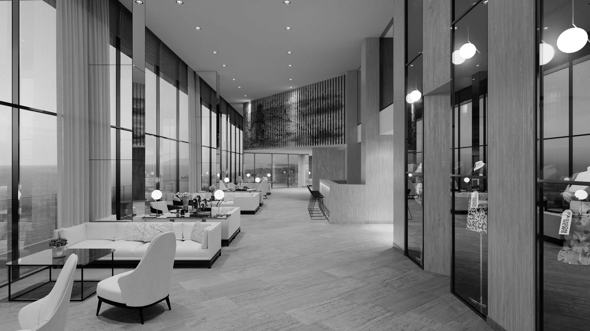
Challenges Faced
Here are a few things that stood out to us
Task 1
Task 2
Feature Extraction
Feature Engineering
Outlier Handling
Resource Constraints
Back to Agenda
Notes:
Feature extraction and feature engineering was a vast task due to the size of the dataset. Due to our constrained resources we need to work out on faster and efficient solutions like PEFT, decreasing precision. The outliers in the data were also present.
For the task 02, as the graphic content was to large so we generated captions which can be further used to train our models efficiently.

Slide 5
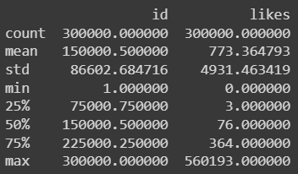
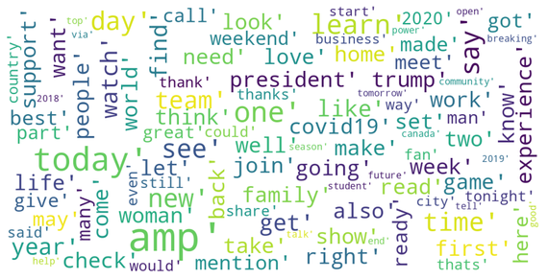
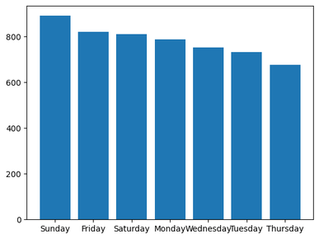

EDA
We saw some interesting trends
Time Dependance
Large Spread
Lots of Words
Likes showed a trend depending on the week day they were posted and at the time they were posted.
There were some tweets with significantly more likes
There were a significant amount of slangs and allusions
What did we do next?
Notes:
Coming to the EDA, we saw some interesting trends in our data. The data was found to be time dependent mainly on day of week and hour. The data was also found to be unbalanced and containing a lot of vocabulary.

Slide 6

Task 1:
Behavior Simulation
Notes:
Let's start with our first task of behavior simulation.

Slide 7
Data Preprocessing
We made sure to clean the data
Cleaning Text
Temporal Feature Extraction
Image Extraction
Embeddings
Lowercasing, removing punctuation and special characters, stopping words, removal of URLs, removing emojis, and correcting spelling and grammatical errors in a single line.
Date, Time, Weekday, Year, Month all were extracted from the given data
Systematically download images for joint visual?textual analysis
Created embeddings for textual and image featues
More on embeds
Notes:
Data Preprocessing was done to ensure proper embeddings are made to train our models. The data was first cleaned then temporal features were extracted. Further preview images were downloaded and embeddings of text and images were created.

Slide 8
Embeddings
We used multiple embeddings for a more robust approach
Second Set of Embeddings
First Set of Embeddings
EfficientNet-b0 + US encoder (all-mpnet-base-v2)
CLIP(base-patch16) + US encoder (all-mpnet-base-v2)
Embedding Dimensions
Embedding Dimensions
1000 + 512
1024 + 768
Media Type Feature were encoded too
Temporal Features were added sperately
Back to Agenda
Notes:
For embeddings generation, we used MPNet-base-v2 fine-tuned on our custom data for the text embeddings. It gave an output of dimension 768. For Image embeddings we firstly tried EfficientNet model to generate embeddings of dimensions 1k.
Further CLIP was used to get a combined embeddings of text and images, with 1024 dimensional embeddings.

Slide 9
Model
Model 4
LGBM: Set 1
Final Model
Model 1
An Ensemble: Using Weighted Average
XGBoost: Set 1
Model 2
FAISS: Set 1
Model 3
XGBoost: Set 2
Selecting the best models
Notes:
These were the models used by us. Each of them will be further explained with the help of a flowchart.

Slide 10
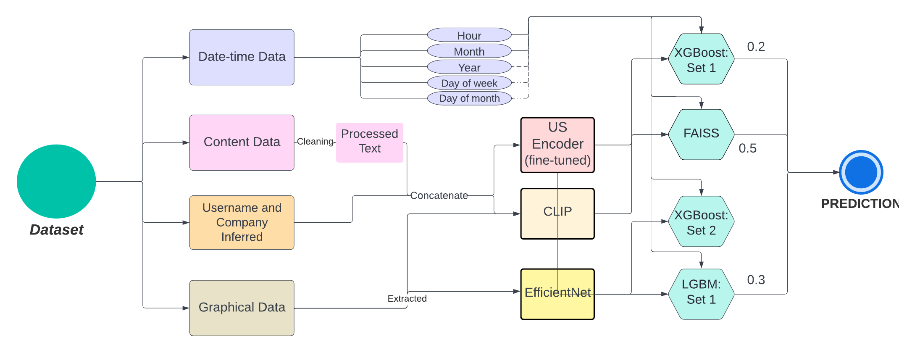
Flow Chart
Flow Chart of task 1
Notes:
The pipeline starts from the data preprocessing steps, followed by embeddings generations. For the unknown time of dataset, we dropped the year data from our model. For the unknown company ones, we used all the data. The US Encoder was used in all of the models as a representation of text_embeddings and EfficientNet was used for LGBM and CLIP was used for training XGBoost. Predictions based on similarity search were made using the FAISS with fine-tuned MPNET and CLIP embeddings.
The final predictions were an ensemble of all these.
The predictions were taken on the log scale, hence reducing the outliers effects.

Slide 11
Citations
Efficientnet pytorch model zoo. https://pytorch. org/hub/nvidia_deeplearningexamples_ efficientnet/
Efficientnet tensorflow hub model. A References https://blog.tensorflow.org/2019/02/
effective-tensorflow-20-best-practices. html.
Google ai blog. https://blog.research.google/. Hugging face model hub. https://huggingface.co/
models?language=ai.
Papers with code. https://paperswithcode.com/.
Askaydevs. 2019. Distilbert github repository. https: //github.com/askaydevs/distillbert-qa.
Authors. 2022a. Bit: Learning deep representations for image and text retrieval. Google AI.
Authors. 2022b. Bloom: Language models are multi- modal and many-modal. BigScience.
Authors. 2022c. Lora: Low-rank optimization for ef- ficiently encoding large language models. Google AI.
Authors. 2022d. Point-efficient transformers. Google AI.
beta-eto code. 2022. Blip2 github repository. https: //github.com/beta-eto-code/bx.model.
bigscience workshop. 2022. Bloom 7b github repository.
https://github.com/bigscience-workshop/ model_card.
dmlc. Xgboost github repository. https://github. com/dmlc/xgboost.
Hugging Face. 2023a. Blip2 hugging face model card.
https://huggingface.co/docs/transformers/ main/model_doc/bit.
Hugging Face. 2023b. Distilbert hugging face model card. https://huggingface.co/docs/ transformers/model_doc/distilbert.
microsoft. Lightgbm github repository. https:// github.com/microsoft/LightGBM.
Microsoft. Lora github repository. https://github. com/microsoft/LoRA.
Victor Sanh, Lysandre Debut, Julien Chaumond, and Thomas Wolf. 2019. Distilbert, a distilled version of bert for efficient inference. Google AI.
Mingxing Tan and Quoc V. Le. 2020. Efficientnet: Re- thinking model scaling for convolutional neural net- works. Google AI.

Slide 12
Thank you!

